Slide 1
PERSONAL WORK REPORT
My work on the Pre-Thesis Demo
Mr.k · Head Programmer
REPORTING WEEK
PROJECT AGE
MY COMMITS
Week of 8-12 Sep 2026
12 Aug – 12 Sep 2026 (≈ 4.5 weeks)
11 of my own, on top of 3 team merges
Every claim in this deck is traceable to a commit in the team repository.
Notes:
Personal report. The next slide sets the boundary between my work and my teammate's before anything is claimed.

Slide 2
BEFORE ANYTHING ELSE
What is mine, and what is not
This project has two programmers. This slide draws the line so nothing later in the deck is ambiguous.
MY WORK
THEIRS, REWRITTEN BY ME
TEAMMATE'S WORK
Written by me
Shared ownership
Not mine
Save system (encrypted)
Room creation & matchmaking
Room browser data layer
Offline / online mode switch
Scene-persistence utilities
Editor tooling
Persistent HUD root
My teammate designed and wrote these as single-player systems. I rewrote them to run under server authority so they work for six players.
Written by the Sub coder and merged into my branch. I am not claiming any of it.
Original single-player design of the systems in the middle column
Downed / revive feature (added 12 Sep, ≈180 lines)
Gameplay prop setup in test scenes
Interaction system
Health & damage
Player movement
First-person camera
Health bar UI
Evidence for this split: my commits vs. the three `git pull` merges in the repository history.
Personal Work Report | Mr.k
01
Notes:
If you only remember one slide from this deck, it is this one. Left column = mine. Right column = my teammate's. Middle = their idea, my multiplayer rewrite.

Slide 3
TRACEABILITY
My commit history
12 Aug
Save system: encrypted save/load, droppable one-off items
MINE
15 Aug
Project tooling and repository setup
MINE
23 Aug
Correction pass on my own earlier work
MINE
23 Aug
— merge: teammate's player movement & camera arrives —
TEAM
01–02 Sep
Room search stops auto-joining; returns every open room. Lobby data layer.
MINE
09 Sep
— merge: teammate's interaction & health systems arrive —
TEAM
09 Sep
Rewrote interaction, health and player control to server-authoritative
MINE
12 Sep
Fixed vanishing interactables and dead damage triggers in offline scenes
MINE
12 Sep
— merge: teammate's downed / revive feature arrives —
TEAM
12 Sep
Four commits driving the two-machine online test to a working state
MINE
Commit messages are in Thai in the repository; translated here. 11 of my own commits, 3 merges bringing in my teammate's work.
Personal Work Report | Mr.k
02

Slide 4
100% MINE
MY WORK · 01
Encrypted save system
What it does
A decision I want to defend
Writes player progression to the machine as AES-256 encrypted JSON, not readable or editable in a text editor.
Loads automatically before the first scene, so no system has to ask whether a save exists.
One static source of truth — no component keeps its own copy of save data to drift out of sync.
Permanent items are capped at one copy and removed on drop, trade or death.
A custom Inspector shows live save contents during Play, so progression bugs are visible without a debugger.
The encryption key is not stored as one string. It is split into four byte arrays and assembled at runtime.
// keys are split so a single string
// cannot be grepped out of the binary
keyPart1 … keyPart4 → GetKey()
A determined attacker with the binary still wins — that is true of any client-side save. The goal is narrower and achievable: make casual save editing not worth the effort, which is what actually damages a co-op game's economy.
347 lines · 4 files · committed 12 Aug 2026
Personal Work Report | Mr.k
03

Slide 5
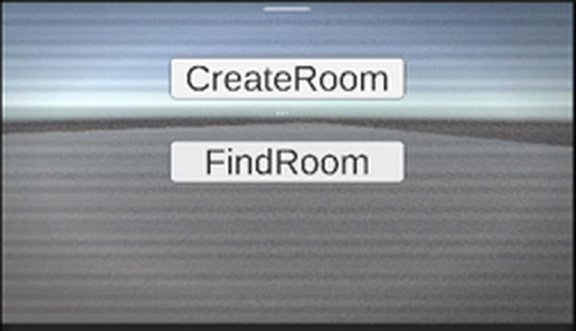
100% MINE
MY WORK · 02
Room creation & matchmaking
1
A room is a data contract, not a button
Map, difficulty, player limit and privacy live in one validated structure. The UI cannot create a room that the join path can't read.
2
The browser knows before you join
Each room advertises its map, difficulty, lock state and a live 2/6 player count — so a player picks a room instead of gambling on one.
From my playtest recording, 12 Sep
Create Room opens a lobby on Epic's service and starts hosting. Find Room searches and returns every open room.
Passwords are never a room attribute
3
I read Epic's lobby API and found that attributes marked private are still readable by anyone searching. So the password is verified after joining, never advertised.
450 lines · 5 files · 1–2 Sep, extended 12 Sep
Personal Work Report | Mr.k
04

Slide 6
THEIR DESIGN · MY REWRITE
MY WORK · 03
Making my teammate's systems multiplayer-safe
My teammate wrote the interaction and health systems as single-player code, which is the right way to write them. My job was the rewrite that makes them survive six players and a hostile client.
BEFORE — single-player
AFTER — server-authoritative
Interaction
Pressing E ran the door's code directly on the machine that pressed it.
The client asks the server which object it wants. The server re-checks distance against its own world before opening anything.
Health & damage
A collider applied damage locally, so each machine saw a different health value.
Only the server applies damage; health syncs outward. Every player sees the same number.
Player control
Every copy of the player prefab read the keyboard — so one key press moved all of them.
Only the locally owned player reads input. Remote copies are driven by the network.
Late joiners
A player joining after a door opened saw it closed.
State is re-applied on connect, so the world is consistent for someone who joins mid-run.
Credit where it is due: the features are my teammate's. The networking model they now run on is mine.
Personal Work Report | Mr.k
05
Notes:
Be explicit when presenting this slide: I did not invent these features. I made them safe to run over a network.

Slide 7
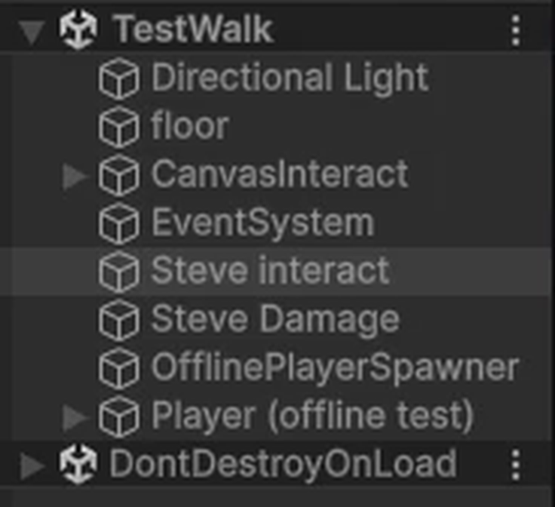
100% MINE
MY WORK · 04
Letting the team test without hosting a match
The problem I had to solve
Mirror switches off every scene object carrying a network identity, so the server controls when it appears. That is correct in a match — and it means a teammate pressing Play in a test scene watches every prop vanish.
What I built
A single offline check every system consults, so gameplay code is written once and behaves correctly with or without a server.
A spawner that places a test player and restores the objects Mirror disabled — and does nothing at all once a match is running.
Persistence helpers so the Epic manager and HUD survive scene changes instead of being destroyed mid-match.
TestWalk in Play mode — props still present
From my playtest recording, 12 Sep
Honest note: this took three attempts. The first two assumed Mirror disables objects before Awake — it does not. The working version stops guessing at Unity's ordering and watches for several frames.
Personal Work Report | Mr.k
06

Slide 8
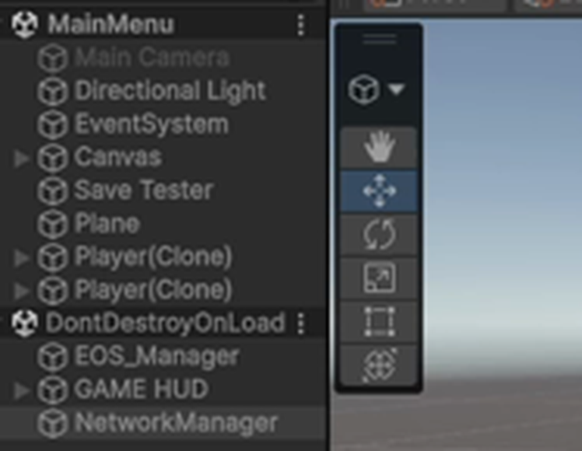
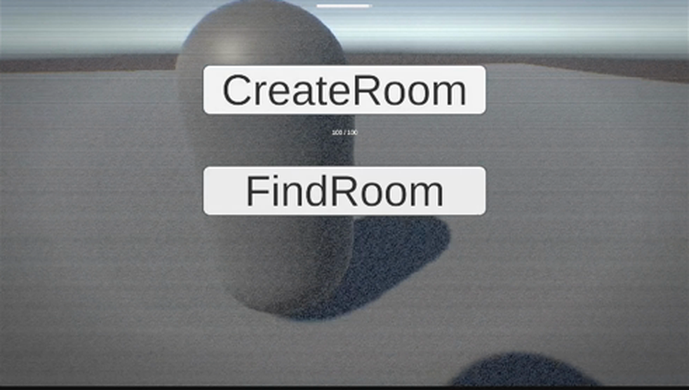
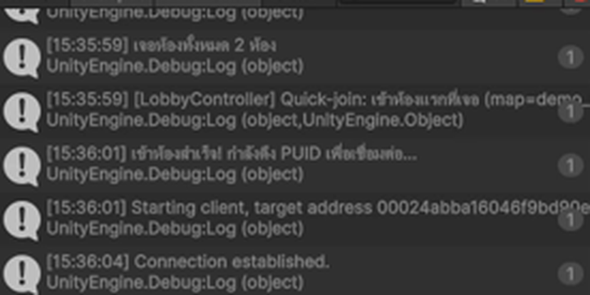
EVIDENCE · 12 SEP 2026
Playtest — two machines, one world
Connection established
Two Player(Clone) in one scene
The client resolved the host's Epic user ID and connected through it — no IP address involved.
Host and joined client both present.
The other player, seen from my client
Recordings supplied with this deck
13-48-04.mp4 (0:54) — offline sandbox: interactables stay present, damage trigger fires
15-35-02.mp4 (1:18) — creating a room on Epic and starting the host
15-35-42.mp4 (0:40) — second client finds the room, joins, and both players appear
Personal Work Report | Mr.k
07
Notes:
Play the three recordings here if the room has time. Frames on this slide are pulled from them.

Slide 9
MY WORK · 05
Bugs I found by reading, not guessing
Each of these had a plausible wrong explanation that would have cost days. I found the real cause by reading the library's own source code.
SYMPTOM
REAL CAUSE
WHAT I DID
Build would not compile
Two Epic SDKs were installed at once, colliding on the same native library.
Removed the unused integration. 0 errors, 0 warnings.
1
Client joined into an empty world
A server can spawn a prefab it references; a client can only spawn one that is registered.
Identified the checkout mismatch between the two machines.
2
Props disappeared on Play
Mirror disables scene objects after Awake, so an Awake-time fix runs too early to see it.
Rewrote the fix to watch across frames.
3
Rooms rejected with InvalidUser
Epic login is asynchronous; the button could be pressed before login finished.
Gated room creation on login state.
4
Damage did nothing
Detection relied on a tag the spawned prefab did not carry — only the old hand-placed player did.
Detect by component instead of tag.
5
Personal Work Report | Mr.k
08

Slide 10
SUMMARY
My contribution in numbers
1,360
1,461
11
5
lines I wrote from scratch
lines I rewrote for multiplayer
commits of my own
hard bugs root-caused
Where my lines went
What the numbers do not show
Lobby & matchmaking
450
The rewrite column is the harder half. Writing a new system is bounded work; changing someone else's working code so it behaves identically for one player and correctly for six — without breaking what they built — is where most of this week actually went.
Save system
347
Networking core
290
Editor tooling
199
Persistent HUD
74
Personal Work Report | Mr.k
09

Slide 11
FORWARD
What I am doing next
1
Room browser UI
The search already returns every open room with its map, difficulty, lock state and player count. Nothing draws it yet — that is my next build.
2
Move the match into a real scene
The online test currently runs in the menu scene. Next is a proper level load with players spawning into it.
3
Private-room passwords
Design is settled — verified after joining, never advertised. Implementation is mine.
4
Start the 13 Rules system
The design thesis of the game and still unstarted. I want it under way before it becomes the thing we ran out of time for.
I will report against this list in next week's personal presentation.
Personal Work Report | Mr.k
10

Slide 12
MY POSITION THIS WEEK
I own the layer everything else
has to stand on.
The connection, the save system, the rule that a client cannot lie to the server, and the ability for my teammate to test his own work without me. None of it is visible in a screenshot of the game — all of it is the reason there is a game to screenshot.
Questions
Personal Work Report | Mr.k
Week of 8-12 Sep 2026

